Slide 1
Transforming steering controls to self driving
Week 1 report
Hongshuo Wang
Professor Siu Ling Leung

Slide 2
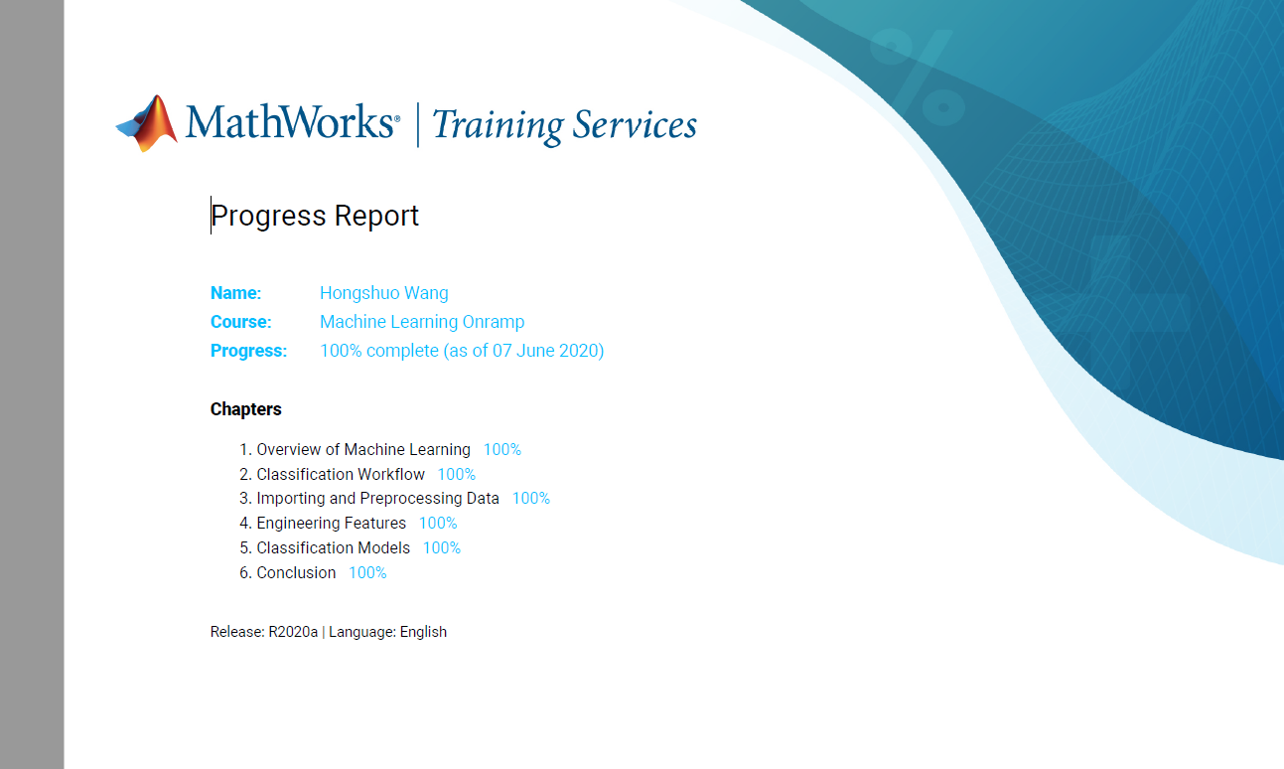
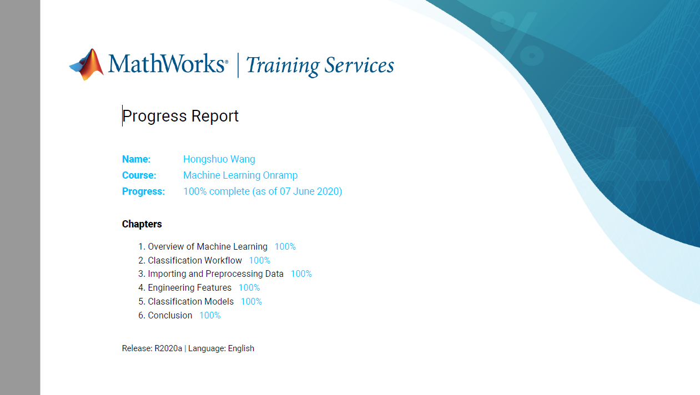
Matlab Certification

Slide 3
Key logic (the process of creating a model)
Import data
Process data
Calculating Features
Build a model
Evaluate the model

Slide 4
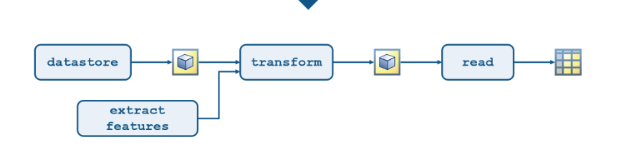
Summary
import data
Read/upload data from file into the system
Create object to store the data
Process data
Transform original data in desired format by scale function
Dealing with missing value by ignoring the missing value
Use other method to do the regression in order to recover the missing value
Normalization/zoom in or zoom out
Calculating features
Use summary statistics to represent feature
Local peak, range, derivatives(difference approx), correlation and aspectRatio
Inf convert to nan/avoid missing data
Create feature extraction function and store the output data into table
Extract features from multiple data files with file_names

Slide 5
Summary
4. Train the model
visualize distribution(boxplot/histogram)
Train data by using specific models
Making prediction by test data
Evaluate the model by
Misclassrate, accuracy and loss
Confusion chart to visualize the specific misclassification
Plot parallel coordinate to investigating features
Improve model
More large training and test data
Add/reduce more parameters
Try different models and pick accurate validation function

Slide 6
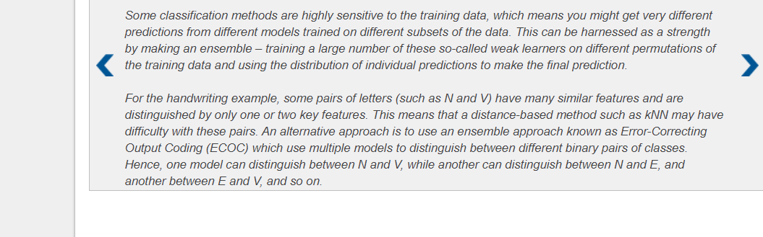
Question about Matlab
Feature Extraction. What kinds of features do we need to pick in our project?

Slide 7
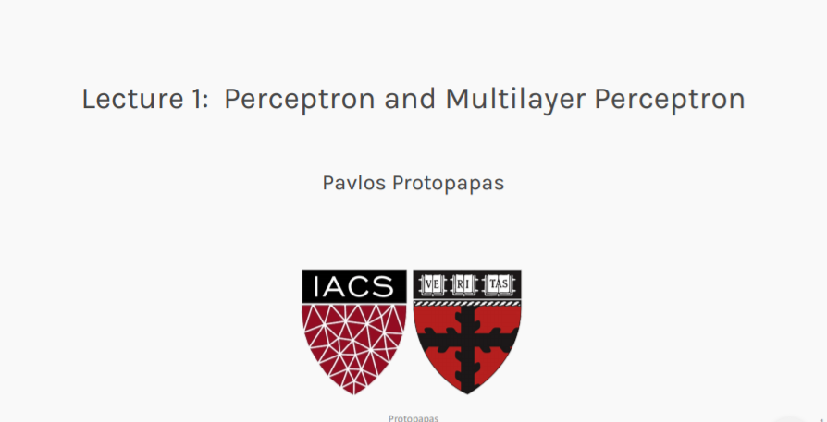
Else: online course

Slide 8
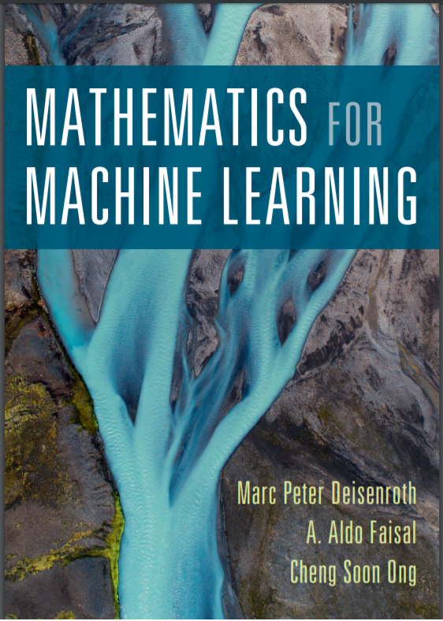
Review the basic ideas of machine learning
PP 1- 127
Reviewed linear algebra and matrix calculation
https://mml-book.github.io/

Slide 9
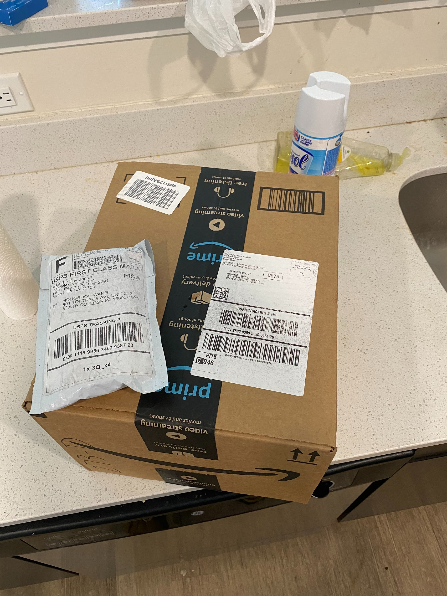
Package arrived

Slide 10
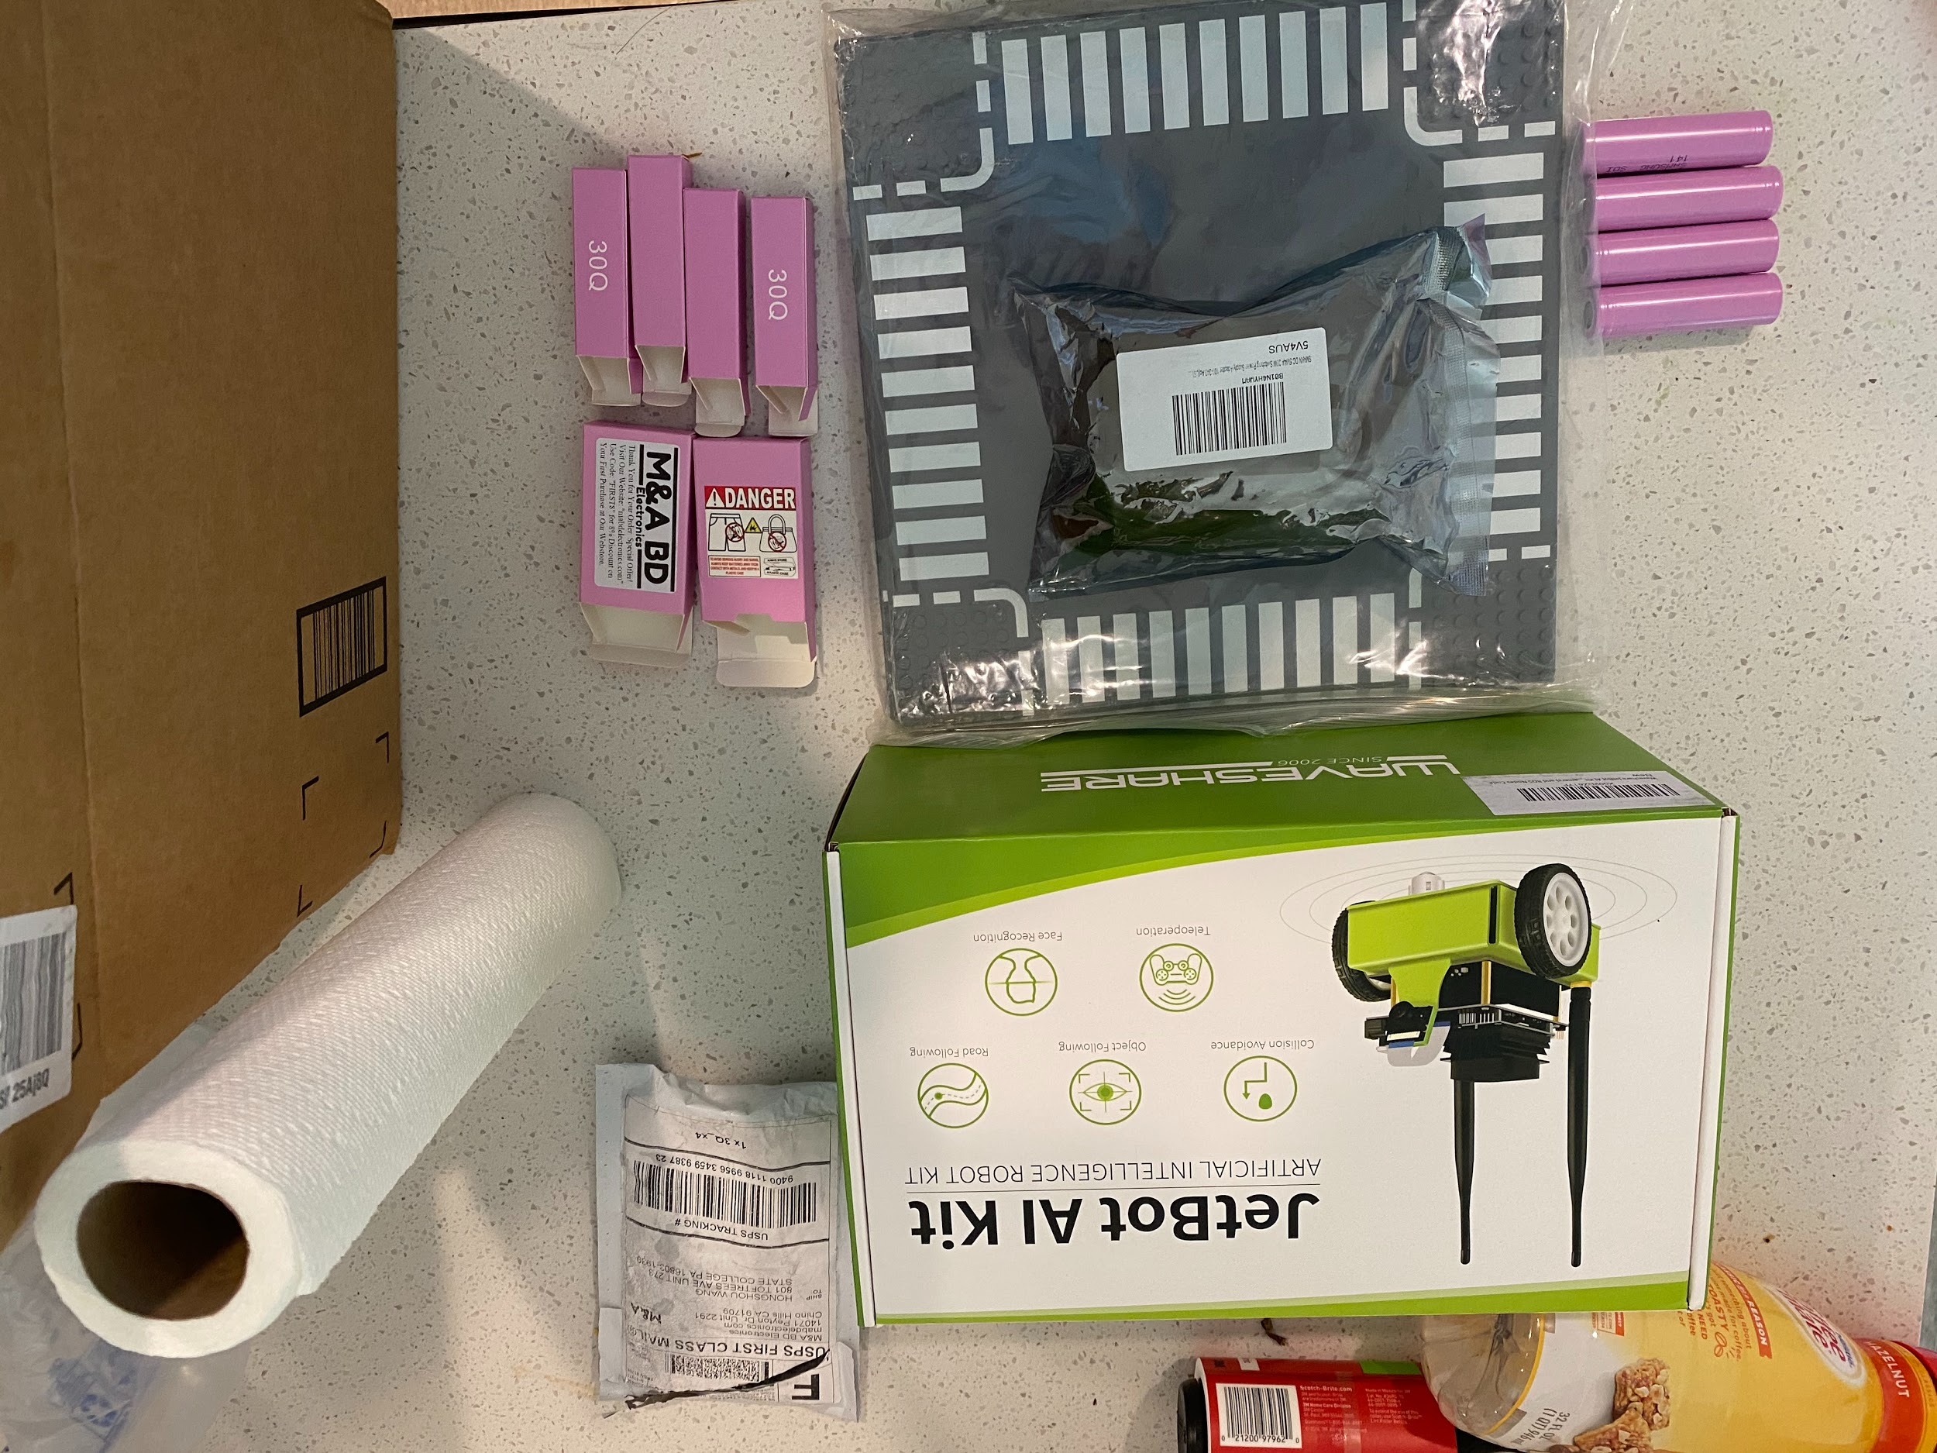
Unpacked

